Slide 1
Drawing blood from a stone: The challenge of articulating student skills!
Ellen Cocking,
The Open University.
Damien Fitzgerald, Nick Nunnington
Sheffield Hallam University.
Arti Kumar,
University of Bedfordshire.

Slide 2
What is STARS?
A well known formula often used by employers seeking personal and specific evidence of ‘skills’ in CV, application form and interview
Situation, Tasks, Actions, Results & Skills
A web-based, interactive, employability resource: www.starsprocess.ac.uk
Contains definitions, examples, guidelines, audio-visual clips, questions and prompts.

Slide 3
Why did we create STARS?
In the employability context, students need to know
employers value skills, attributes and results gained from a range of situations, tasks and actions
in addition to academic activities their non-work and extra-curricular experience has ‘employability value’
how to link and promote their skills and experience effectively
they have many more options and potential destinations than narrowly perceived discipline-specific job opportunities
careers advisors and tutors are under considerable pressure to cope with demand
This resource should help

Slide 4
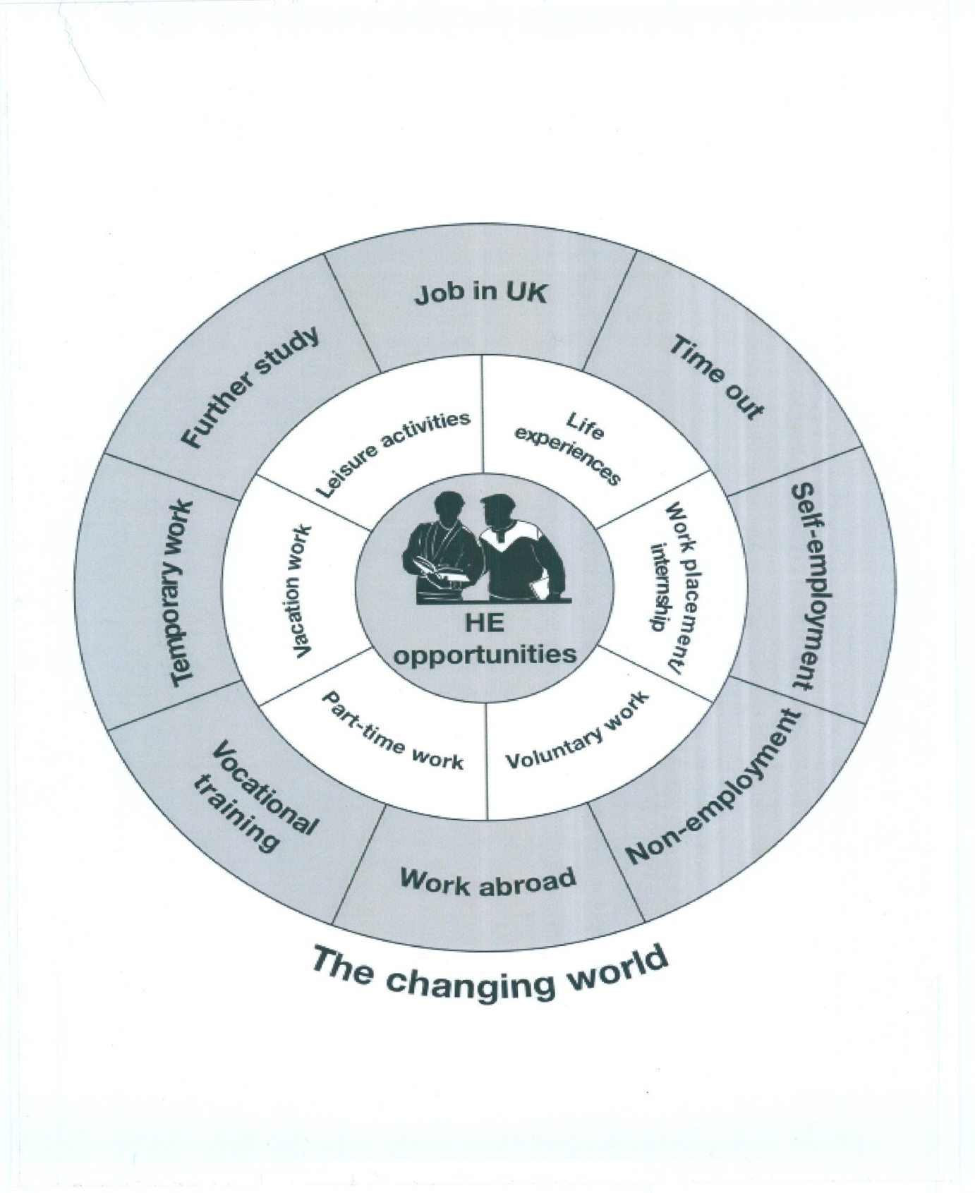
Contextualising STARS within a Career Management Skills framework
e.g. engaging ‘self’ with ‘oppportunity’
testing out aspirations
achieving results
(Kumar, A. SOARing to Success)

Slide 5
STARS can help students and graduates to:
Understand the lexicon of ‘skills’
Identify situations that develop skills
Appreciate what employers are seeking
Reflect and create their own evidence of skills development
Value learning from extra-curricular and life-wide experiences
Express the value of their experiences and
articulate their skills convincingly

Slide 6
The STARS tool

Slide 7
The STARS tool in practice

Slide 8
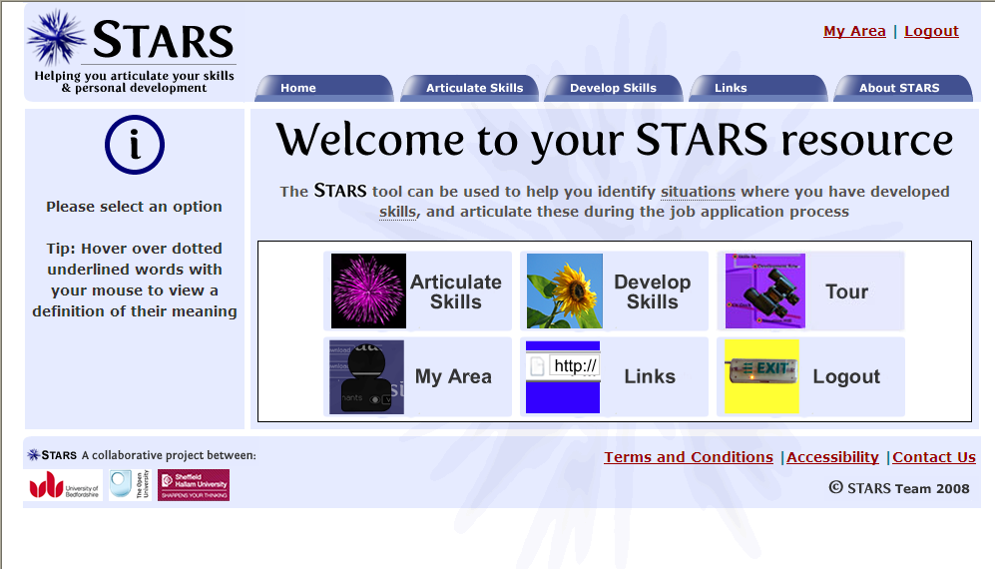
The STARS tool in practice

Slide 9
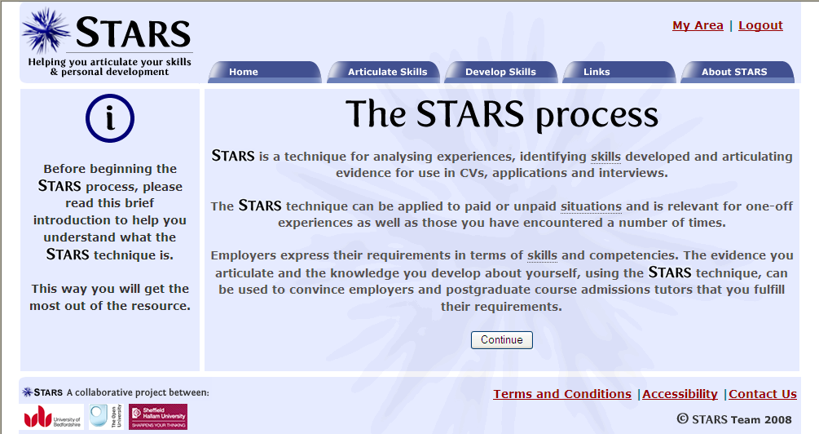
The STARS tool in practice

Slide 10
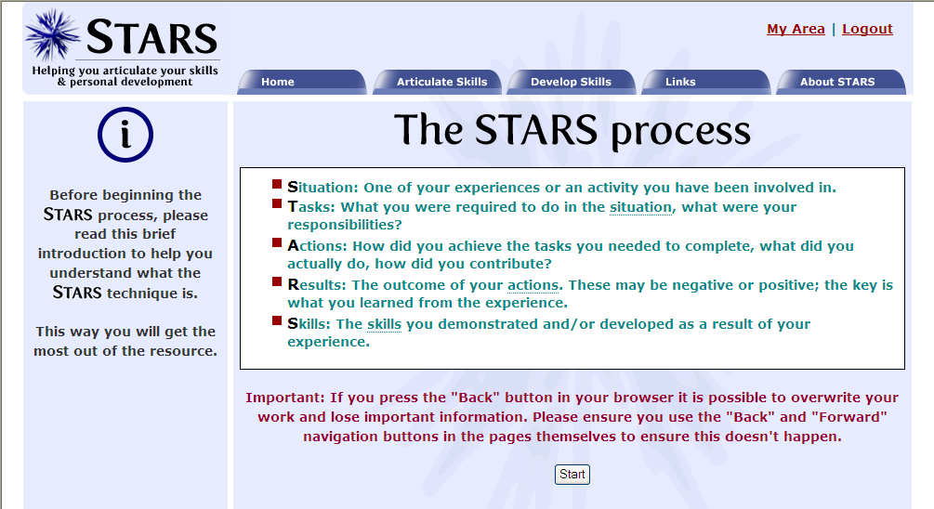
The STARS tool in practice

Slide 11
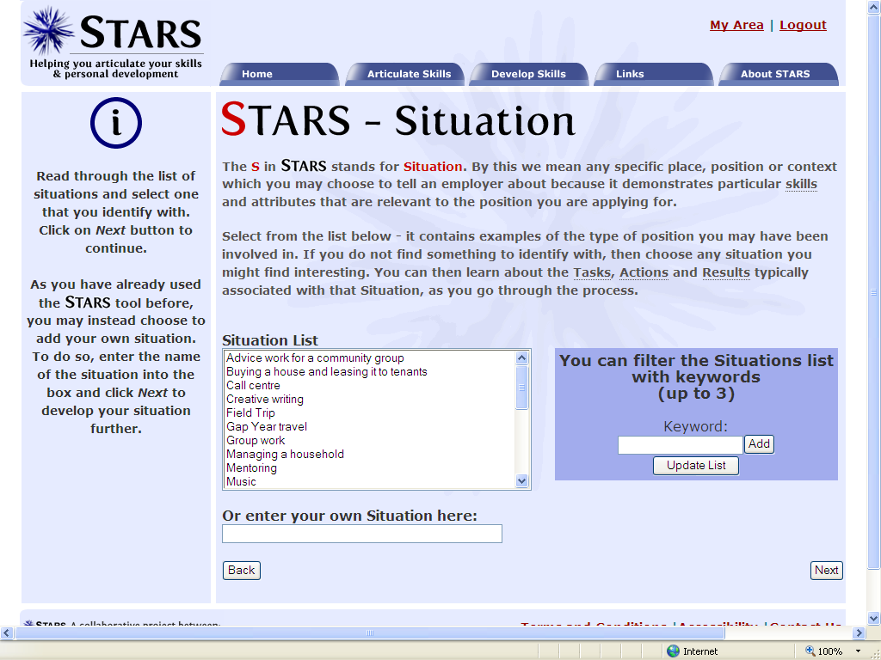
The STARS tool in practice

Slide 12
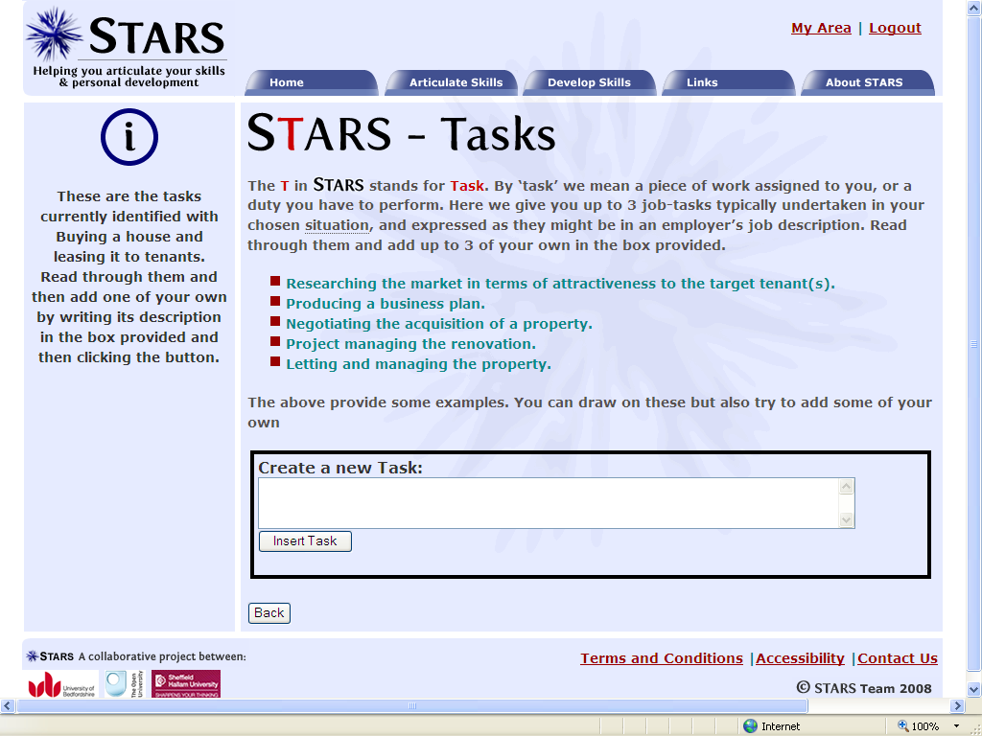
The STARS tool in practice

Slide 13
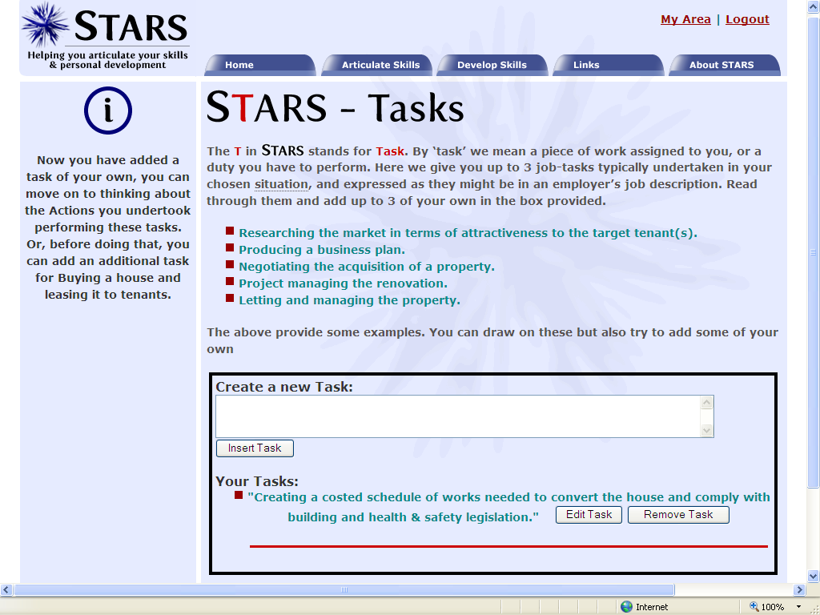
The STARS tool in practice

Slide 14
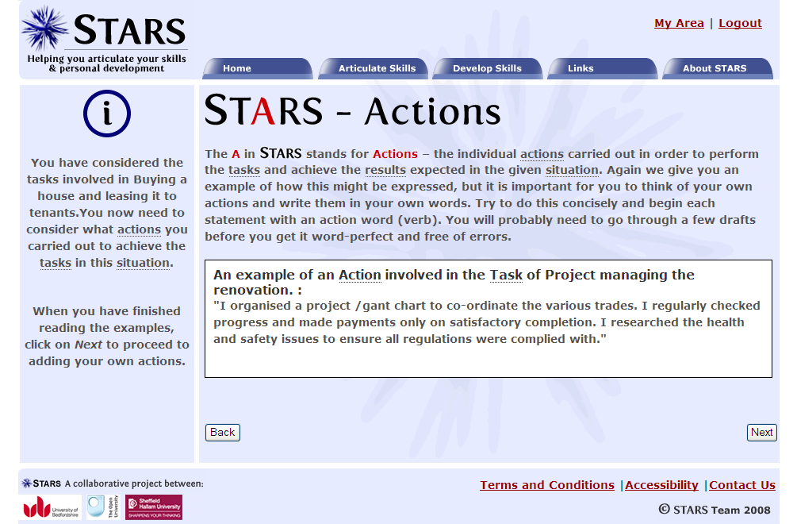
The STARS tool in practice

Slide 15
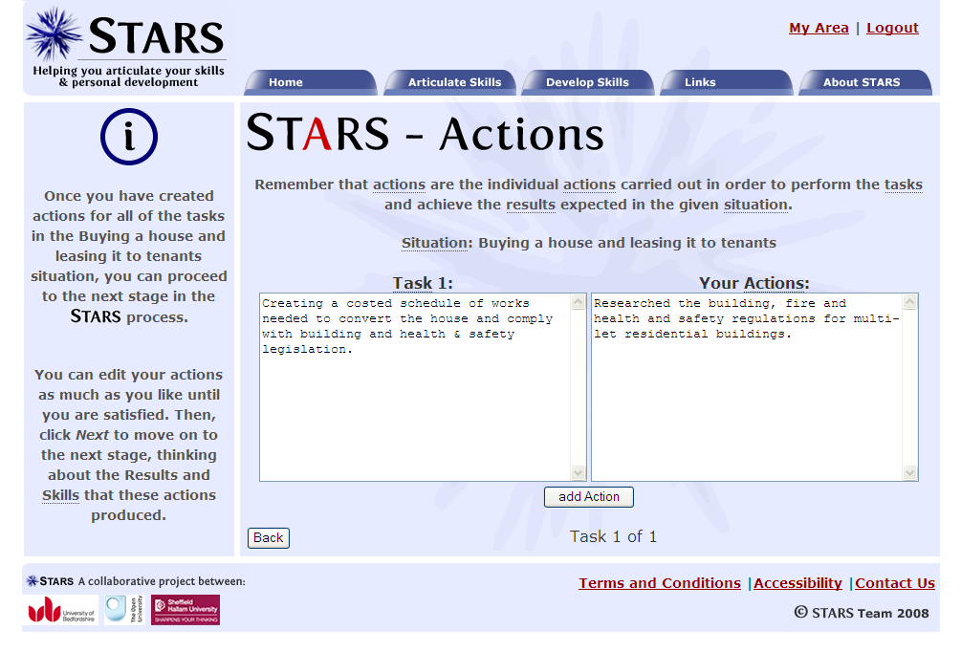
The STARS tool in practice

Slide 16
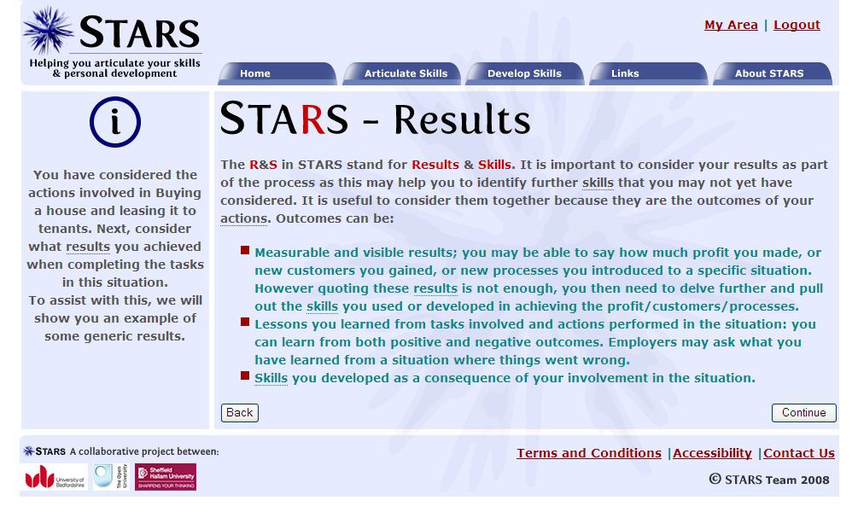
The STARS tool in practice

Slide 17
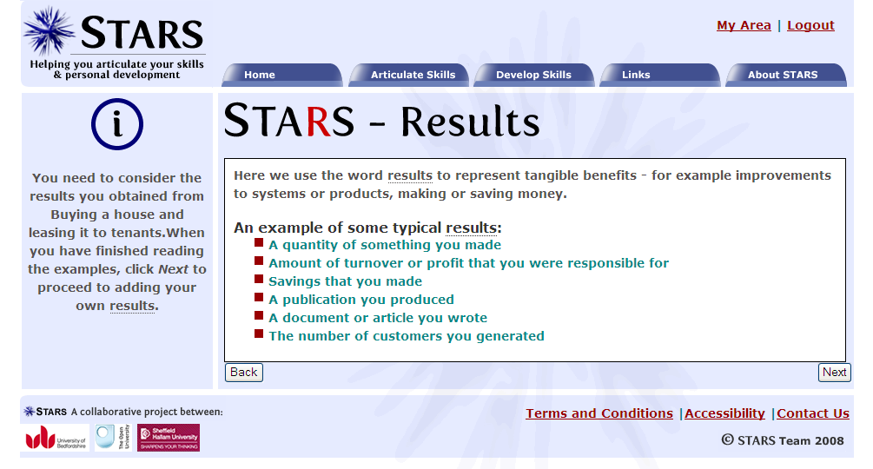
The STARS tool in practice

Slide 18
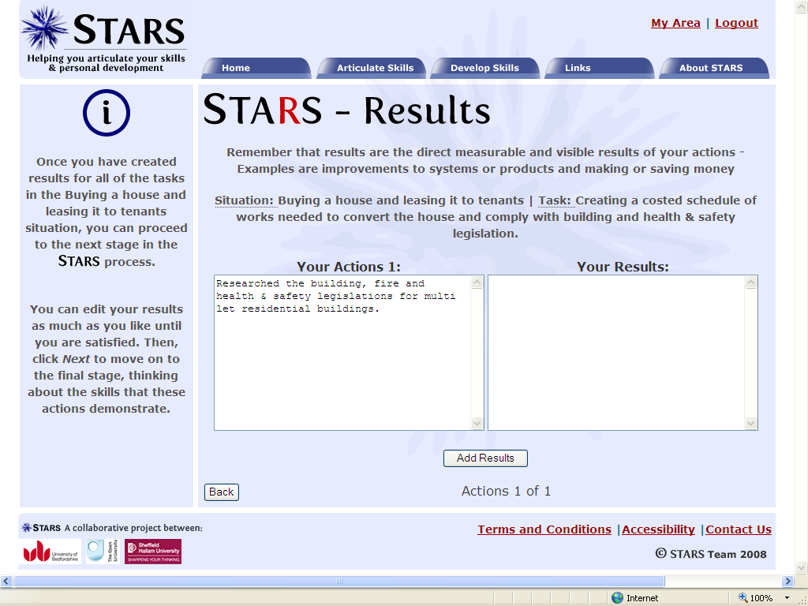
The STARS tool in practice

Slide 19
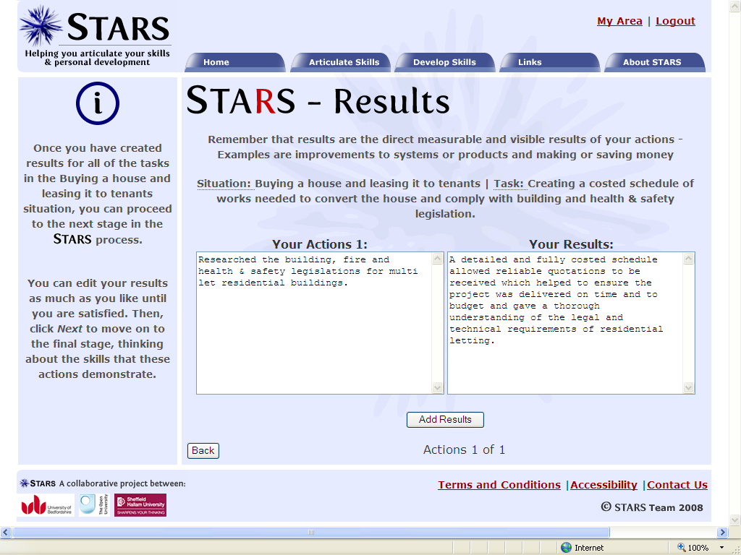
The STARS tool in practice

Slide 20
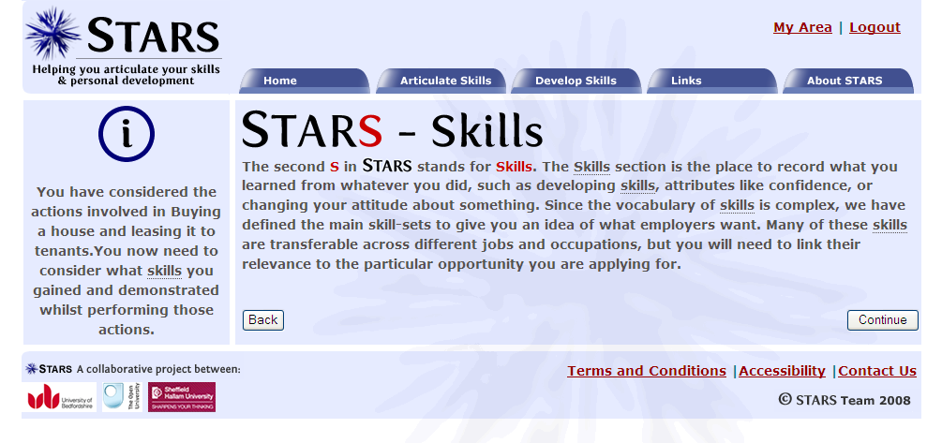
The STARS tool in practice

Slide 21
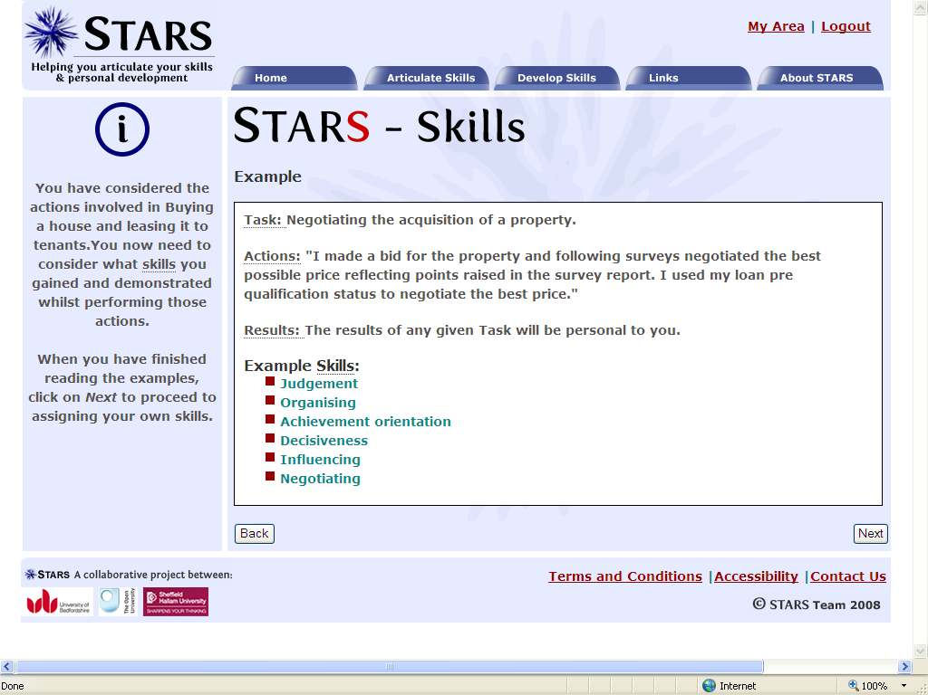
The STARS tool in practice

Slide 22
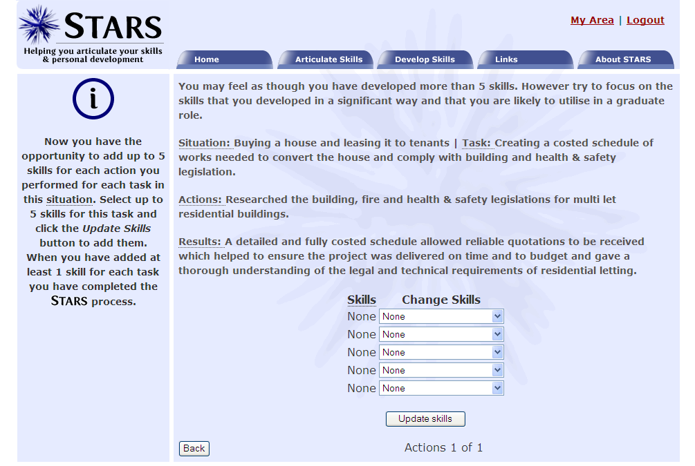
The STARS tool in practice

Slide 23
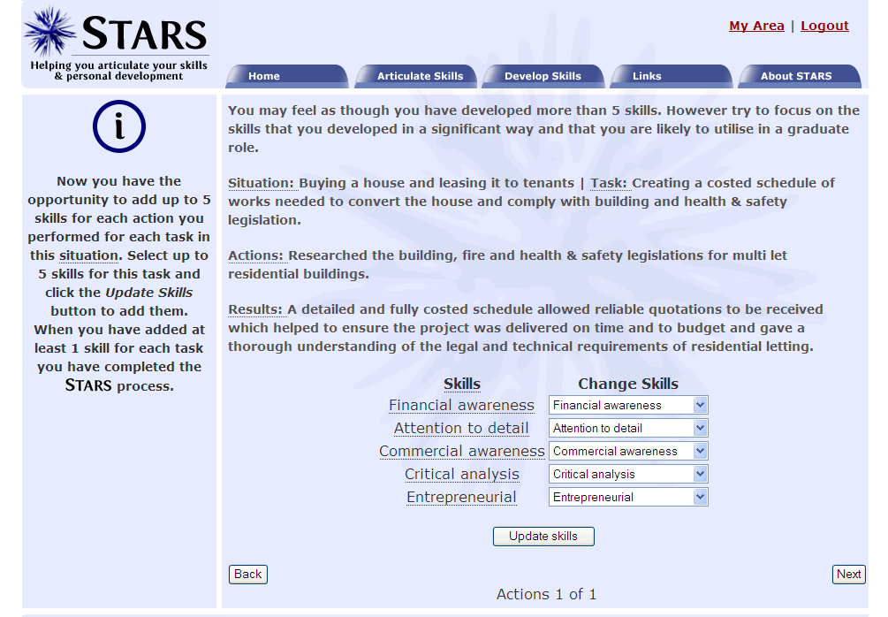
The STARS tool in practice

Slide 24
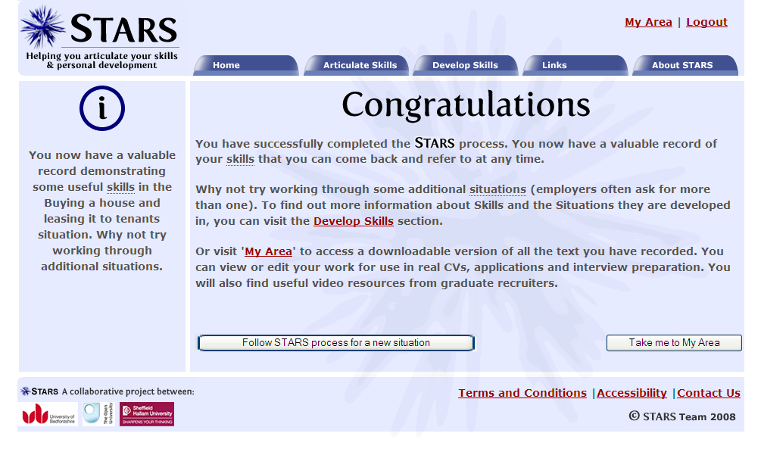
The STARS tool in practice

Slide 25
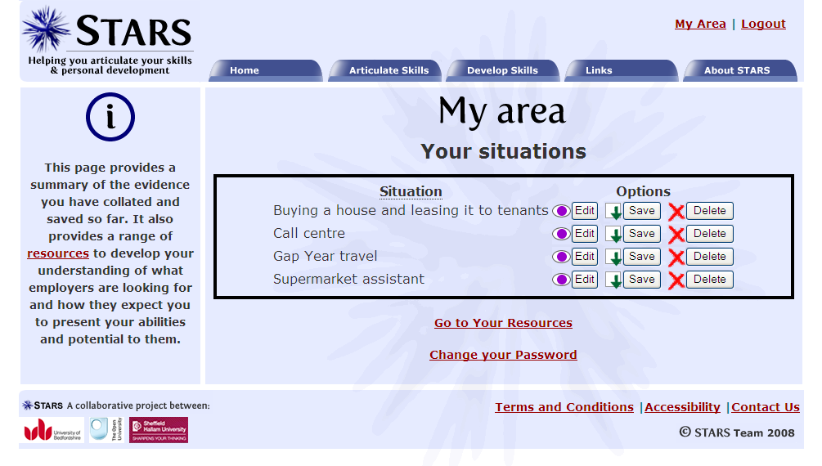
The STARS tool in practice

Slide 26
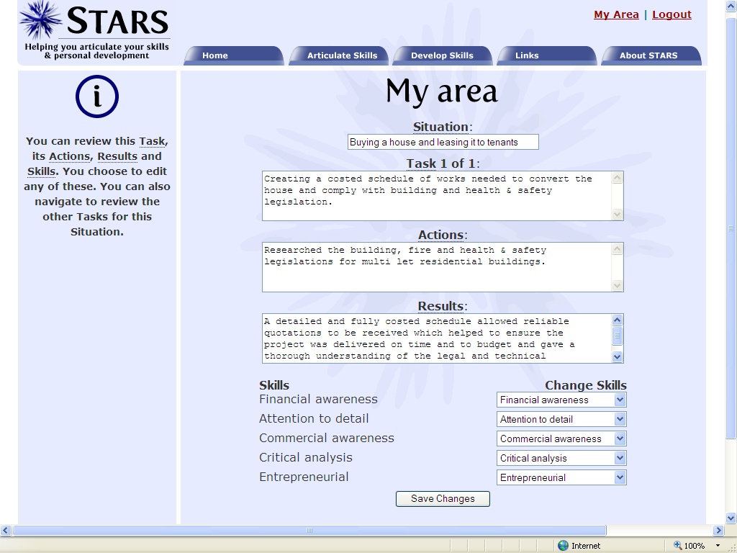
The STARS tool in practice

Slide 27
The STARS tool in practice

Slide 28
The STARS tool in practice

Slide 29
References
Archer, W. and Davison, J. (2008) Graduate Employability: what do employers think and want? Council for Industry and Higher Education (CIHE). Available online, last accessed 25 Feb. 09.
http://www.cihe-uk.com/docs/PUBS/0802Grademployability.pdf
Burgess, R. (2007) Measuring and Recording Student Achievement: report of the Scoping Group. London, Universities UK and SCOP.
Stefani, L., Mason, R. & Pegler, C. (2007) The educational potential of e-portfolios London and New York: Routledge, Taylor & Francis.
Kumar, A.(2007) Personal, Academic and Career Development in Higher Education – SOARing to Success London & New York, Routledge Taylor & Francis. Companion website last accessed 25 Feb. 09
http://www.routledge.com/professional/978041542360-1/

